Slide 1
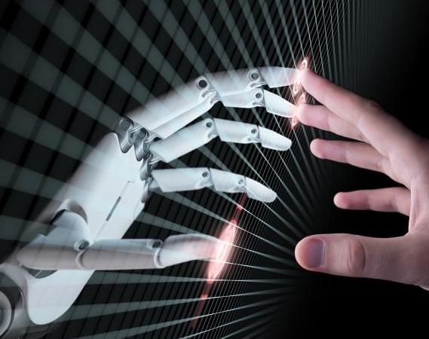
Hand Gesture Recognition using Deep Learning
Data Mining & Machine Learning 2
M.S. in Data Analytics, Group B
Abhinav Thapa – 20259409
Tejas Mahesh Jadhav – 20206861
Rupesh Sai Baba Chintakayala – 21104638

Slide 2

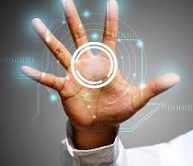
Introduction
Hand Gesture Recognition systems find its immense application in wide range of domains which include or may incorporate automated gesture-based utility of machines that are currently being operated manually.

Slide 3

Project Objective
This project aims to explore and develop a system that can recognize and classify hand gestures using deep learning methods and evaluate the extent to which the combination of CNN with LSTM and GRU (Gated Recurrent Unit) model assist in addressing this problem better.

Slide 4
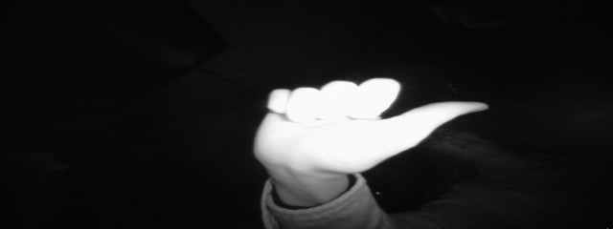
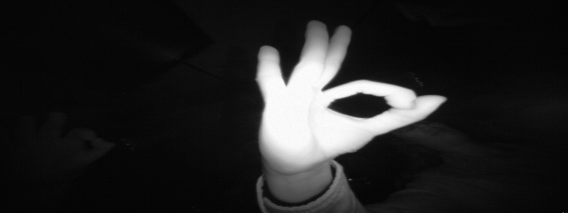
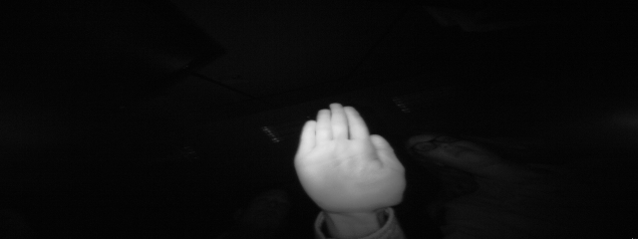
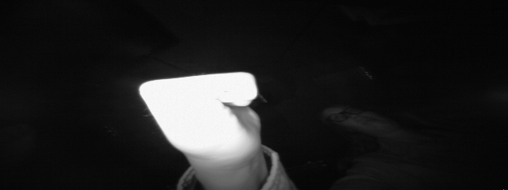
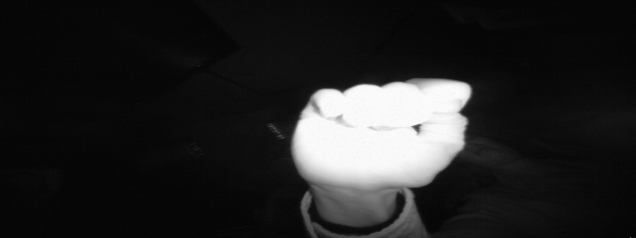
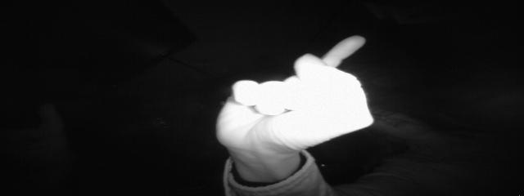
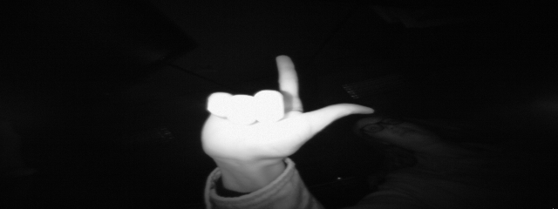
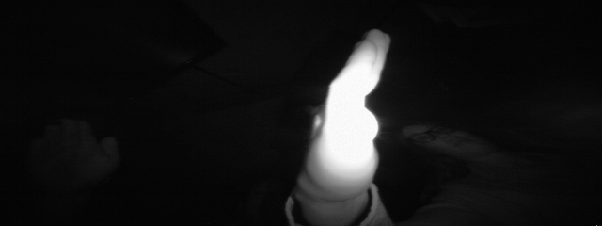
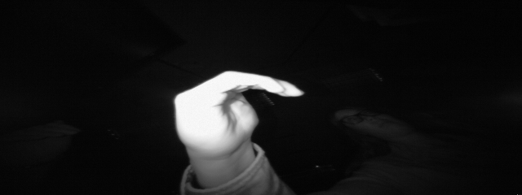
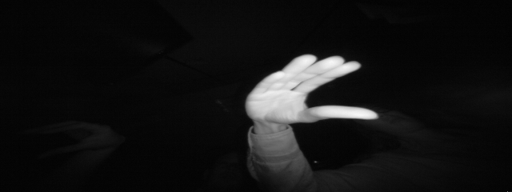
Dataset

Slide 5
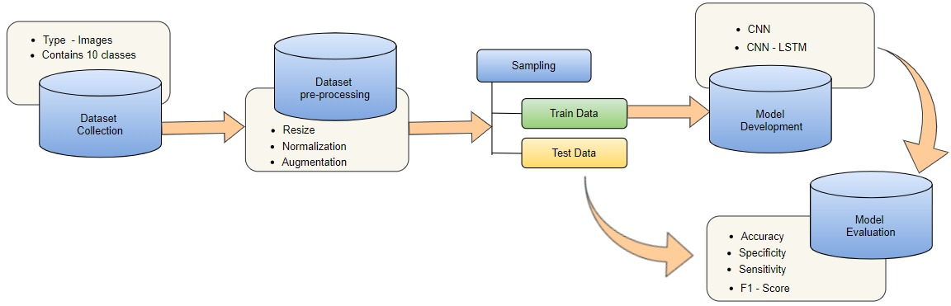
Methodology
Apart from being cost-effective and simple, KDD provides a set of iterative steps which can assist in enhancing and refining the project execution and provide more appropriate insights.
The following steps were followed:
Data Collection
Data Preparation
Modeling
Model Evaluation
Results and Conclusions

Slide 6

Demo

Slide 7
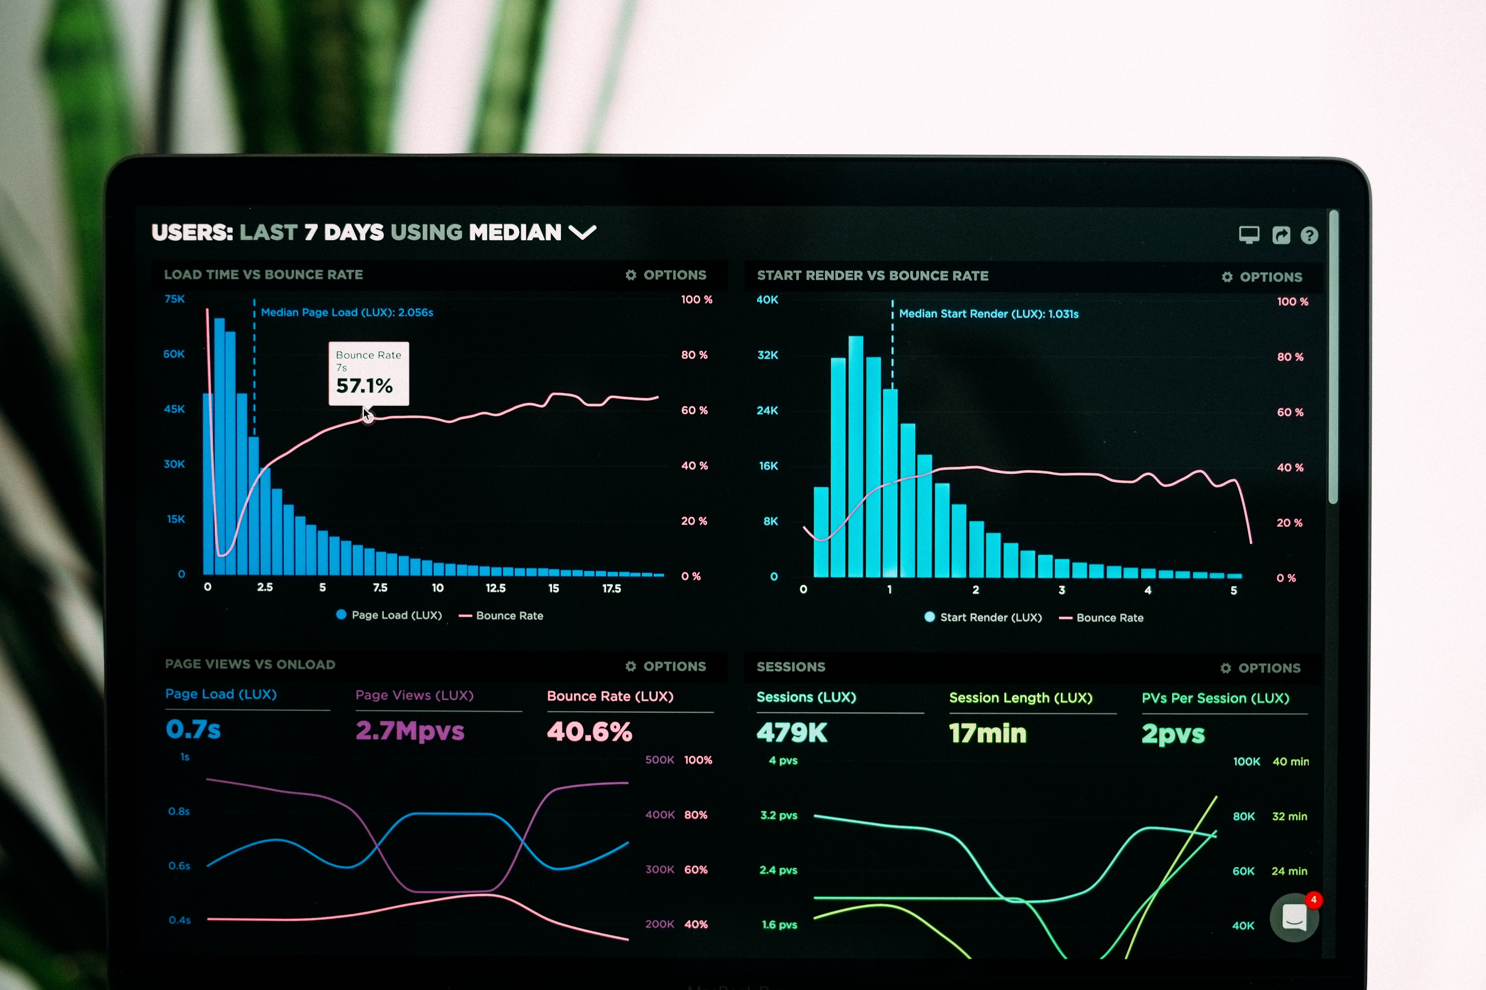
Visualizations

Slide 8
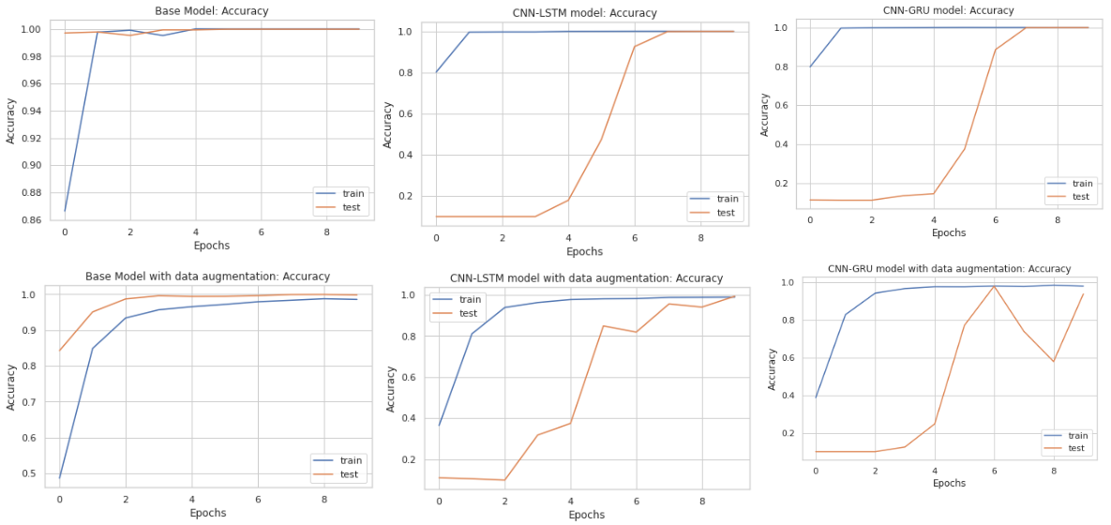
Accuracy graph for all models

Slide 9
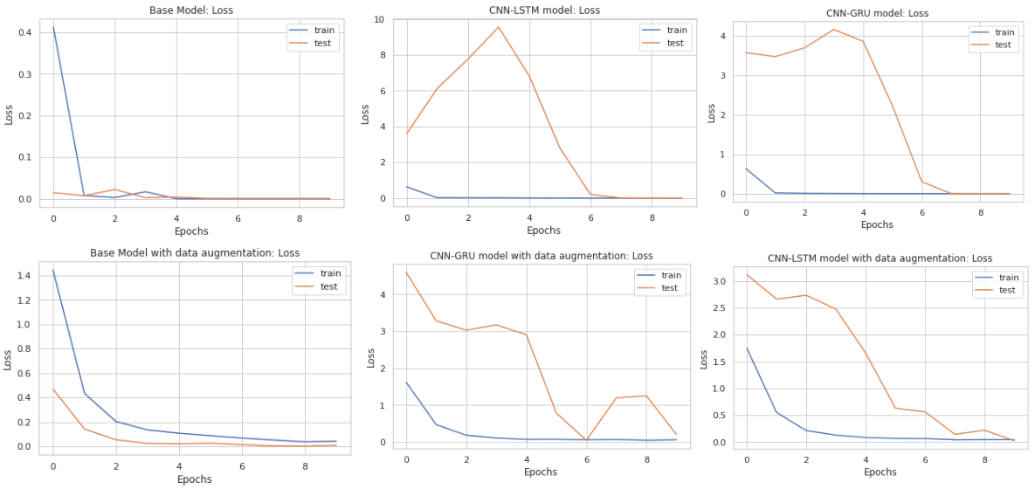
Loss graph for all models

Slide 10

Results & Conclusion
Evaluating multiple deep learning image recognition models such as CNN (base), CNN-LSTM and CNN-GRU with and without augmented data provided an in-depth insight into their workings on a public dataset available on Kaggle. We observed the highest accuracy and a comparable speed for execution for the CNN-LSTM model which suits our requirement due to the availability of an enriched dataset. However, when dealing with a lower quality dataset, we can use the CNN-GRU for similar results with higher speed.

Slide 11


